Slide 1
Programming with B4X
Lesson 7 – Conditionals
Anywhere Software
Feb 2021

Slide 2
Today you will learn
Boolean Variables
Relational Operators
Logical Operators
If Statement
If-Else Statement
If-Else If Statement
MAX Algorithms

Slide 3

Logical Variables
Private intDistance = 100, intTotalTravel = 0 As Int
Private blnFlag As Boolean = False
Private blnDone As Boolean
Boolean Variables stores two different values: True False
Notes:
So far, we have seen three types of variables integer, real, and string. As a type it is extremely simple because it can accept only two different values: True – False which in fact internally on the computer are translated into states 1 and 0 (leaked by current or not).
The statement of a logic (from now on we will call it Boolean) becomes like the other simple variables we have known

Slide 4
Comparative Operators
Symbol | B4X | Meaning
= | = | Equality
≤ | <= | Smaller or Equal
≥ | >= | Greater or Equal
≠ | <> | Different
< | < | Smaller
> | > | Larger
Notes:
Comparative operators are used to make comparisons between values in the programming languages. They are the known mathematical symbols of inequalities only that on the computer are written in a slightly different way.

Slide 5
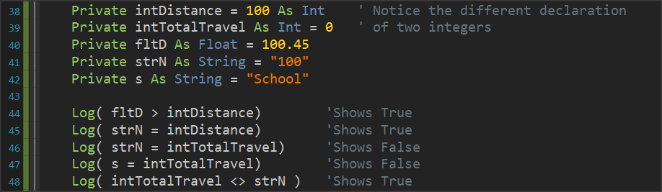
Examples
The result of a comparison is always a logical value of True or False.

Slide 6
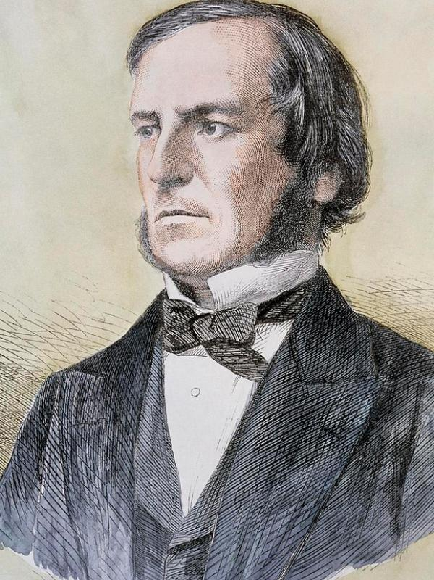
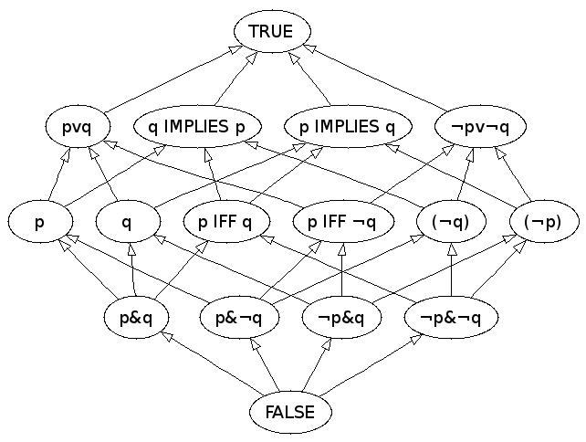
Boolean Algebra
Let me introduce you George Boole
Hi, George
George you are best known as the author of The Laws of Thought
Isn’t true?
Yes, it is, and it’s super cool if you read about it
So, can you explain to us?
Hi
Notes:
In Mathematics and Mathematical Logic, Boolean Algebra is the algebra where the values of the variables are the true and false, usually represented by 1 and 0 respectively. Unlike elementary algebra where the values of variables are numbers and the main acts are addition and multiplication, in Boolean there are three main acts And, OR and Denial No

Slide 7
Boolean Algebra
Consider a sentence such as “I am going to school now”.
And a second sentence such as “Its raining cats and dogs”

Slide 8
Boolean Algebra
S1: “I am going to school now”
S2: “Its raining cats and dogs”
(s1) | (s2) | S1 AND S2 | S1 OR S2 | NOT S1
True | True | True | True | False
True | False | False | True | False
False | True | False | True | True
False | False | False | False | True
Notes:
Two sentences that unite with the logical AND are true when it unites two truths only.
Two sentences that are united by logical OR are true when even one sentence is true.
The logical NO reverses the truth or lie of a sentence.

Slide 9
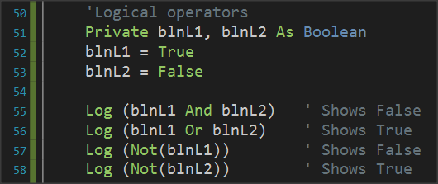
Logical operators in programming
Notice that logical operations must link logical variables or logical expressions.
Notes:
Logical operators are used in programming to create complex comparative expressions. This helps the developer optimize their code with fewer lines and simpler code.

Slide 10
Example 1
strName1 | = | “George” | OR | strName2 | = | “John”
George |  | George |  | Georgia |  | John
 | True |  |  |  | False
 |  |  | True

Slide 11
Example 2
Private intA = 10, intB = 20, = 30 As int
Private strName1 = “George”, strName2 = “Georgia” As String
Private blnA = True, blnB = False blnC = False As Boolean
blnA | AND | blnB
True |  | False
 | False

Slide 12
Example 3
Private intA = 10, intB = 20, = 30 As int
Private strName1 = “George”, strName2 = “Georgia” As String
Private blnA = True, blnB = False blnC = False As Boolean
intA | > | intC | AND | blnA
10 |  | 30 |  | True
 | False
 |  |  | False

Slide 13
Example 4
Private intA = 10, intB = 20, = 30 As int
Private strName1 = “George”, strName2 = “Georgia” As String
Private blnA = True, blnB = False blnC = False As Boolean
intA + intB | >= | intC | AND | (blnA | OR | blnB)
10 + 20 |  | 30 |  | True |  | False
 | True |  |  |  | True
 |  |  | True

Slide 14

If command
If ( condition ) Then
Commands
End If
If condition is TRUE execute the commands between Then and End If
Notes:
Often as in life we ask questions so in programming there is a need for the developer to ask questions to check values or change the continuity of the program in different directions.
The if command is used to make the corresponding questions

Slide 15
Examples
Private intA = 10, intB = 20 As Int
If intA > 0 Then
Log(intA & " is possitive Number")
End If
If intA > 10 Or intB > 10 Then
Log("One or both numbers are greater than 10")
End If
If intA Mod 2 = 0 Then
Log(intA & " is Even number")
End If

Slide 16
If – else command
If ( condition ) Then
Commands
Else
Commands
End If
If condition is TRUE execute the commands between Then and Else or Else execute the code between Else and End If
Notes:
Often as in life we ask questions so in programming there is a need for the developer to ask questions to check values or change the continuity of the program in different directions.
The if command is used to make the corresponding questions

Slide 17
Examples
Private intA = 10, intB = 20 As Int
If intA > 0 Then
Log(intA & " is possitive Number")
Else
Log(intA & " is not possitive Number")
End If
If intA > 10 Or intB > 10 Then
Log("One or both numbers are greater than 10")
Else
Log("None of the two numbers are greater than 10")
End If

Slide 18
Example
Private intA = 10, intB = 20 As Int
If intA Mod 2 = 0 Then
Log(intA & " is Even number")
Else
Log(intA & " is Odd number")
End If

Slide 19
If – else - else if
If ( condition1 ) Then
Commands
Else If (condition2 ) Then
Commands
Else If ( condition3 ) Then
Commands
Else If ( condition4 ) Then
Commands
...
Else
Commands
End If
Notes:
The function of the multiple if is summarized as follows:
The first condition runs, and if it is true, then the code it contains runs and if it is completed.
If the first if is false then the second is executed and if it is true it executes the code it contains and if it is completed
Other checks are always performed when the previous ones are false.
If none of the checks are true then the else command is run which is optional.

Slide 20
Example 3
A fast-food chain has these meals:
Meal Price
Burger 5$
Pizza 3$
Hot Dog 1,5$
Create a program that:
Reads the meal the customer wants. Prints the cost of the meal. Input example: "Hot Dog", Output: "Hot Dog 1,50$"

Slide 21
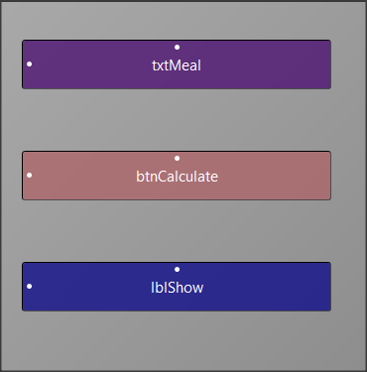
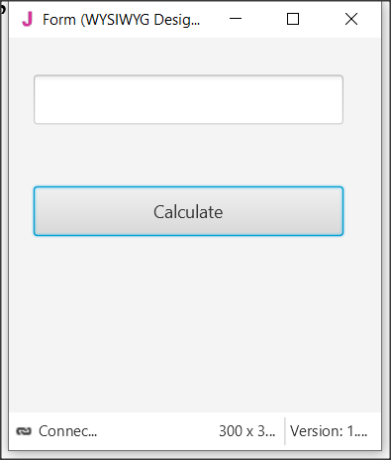
Step 1
Start a new project and give dimensions 300 x 300.
Step 2
In the designer design the app screen

Slide 22
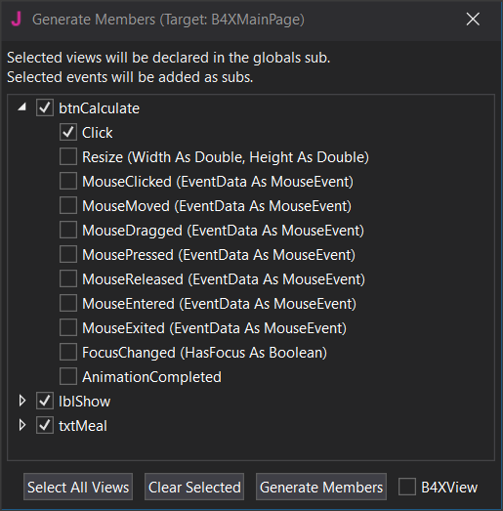
Step 3
Enter txtMetal , btnCalculate, lblShow , and btnCalculate_Click.

Slide 23
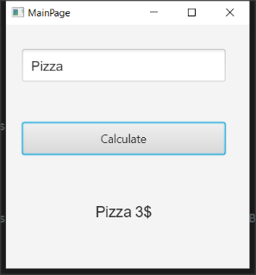
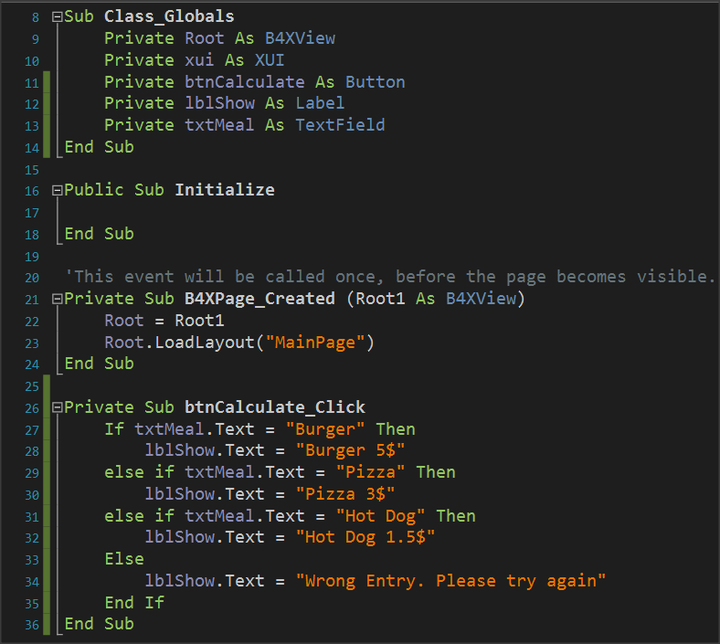
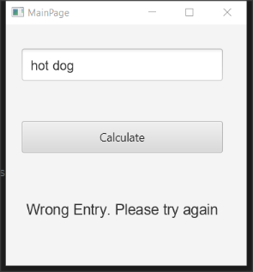
Code for btnCalculate_Click

Slide 24
Maximum Algorithms, Method 1 – Simple If Statement
If Inta > intB AND Inta > intC then
Log(Inta)
End If
If intB > Inta AND intB > intC then
Log(intB)
End If
If intC > Inta AND IntC > intB then
Log(intC)
End If

Slide 25
Maximum Algorithms, Method 2 – Nested If Statements
If intA > intB then
If intA > intC then
Log(intA)
End If
End If
If intB > intA then
If intB > intC then
Log(intB)
End If
End
If intC > intA then
If intC > intB then
Log(intC)
End If
End If

Slide 26
Maximum Algorithms, Method 3 – Max
Max = intA
If intB > Max then
MAX = intB
End If
If intC > Max then
MAX = intC
End If
Log(Max)

Slide 27
Thank you!!!
Photos taken From:
https://en.wikipedia.org/wiki/George_Boole
https://en.wikipedia.org/wiki/If%E2%80%94

